Slide 1
Chapter 4.3
Properties of Functions and Set Cardinality
Chapter 4.4
Properties of Relations
...
Written by Rachel J. Morris, last updated 11/21/16

Slide 2
Properties of Functions
Onto:
One-to-one:
A function f is onto if everything in the codomain really is an output of f. That is, for every element y in the codomain, there must be (at least one) x in the domain where f(x) = y.
A function f is one-to-one if nothing in the codomain is an output via two different inputs. That is, for every choice of different elements and in the domain, and must be different.

Slide 3
Properties of Functions
Invertible:
A function f is a one-to-one correspondence if it is both one-to-one and onto. This is equivalent to saying that f is invertible.
Another way of stating this is:
The function is invertible if there is a function such that
if and only if .
The notation is read as “f inverse” and the symmetry of the definition means that .

Slide 4
Properties of Functions
In diagramming terms...
A function is onto if every point in the codomain has an arrow ending at that point.
A function is one-to-one if no point in the codomain has two or more arrows ending at a point.
A function is a one-to-one correspondence (invertible) if every point in the codomain has exactly one arrow ending at that point.

Slide 5
Properties of Functions
Onto?
Yes, every point in the codomain has an arrow leading to it.
One-to-one?
Yes, there is no point in the codomain that is pointed to from two or more sources in the domain.
Invertible?
Yes, as it is both onto and one-to-one.
1
2
A
B
1
2
A
B

Slide 6
Properties of Functions
Onto?
Yes, every point in the codomain has an arrow leading to it.
One-to-one?
No, “B” is pointed at from two sources.
Invertible?
No, the inverse of f is not a function.
1
2
3
A
B
1
2
3
A
B

Slide 7
Properties of Functions
Onto?
No, “C” has nothing pointing to it.
One-to-one?
Yes, there is no point in the codomain that is pointed to from two or more sources in the domain.
Invertible?
No, the inverse of f is not a function.
1
2
A
B
C
1
2
A
B
C

Slide 8
Properties of Functions
Onto?
No, “B” in the codomain does not have an arrow pointing to it.
One-to-one?
No, “A” is being pointed to by two sources.
Invertible?
No, the inverse of f is not a function.
1
2
A
B
1
2
A
B

Slide 9
Properties of Functions
Without diagrams...
Given the function:
Why is this function not onto?(for every element y in the codomain, there must be (at least one) x in the domain where f(x) = y.)
Can we find some x that gives us an f(x) not in the set of all real numbers?

Slide 10
Properties of Functions
Without diagrams...
Given the function:
Why is this function not onto?(for every element y in the codomain, there must be (at least one) x in the domain where f(x) = y.)
Can we find some x that gives us an f(x) not in the set of all real numbers?
How about f(x) = 0? We can find the roots with the quadratic formula...
This isn’t in the set!

Slide 11
Properties of Functions
Without diagrams...
Given the function:
Why is this function not onto?(for every element y in the codomain, there must be (at least one) x in the domain where f(x) = y.)
Therefore, this function is not onto, and not invertible.

Slide 12
Properties of Functions
Without diagrams...
Given the function:
Why is this function not one-to-one?(A function f is one-to-one if nothing in the codomain is an output via two different inputs.)
Can we get the same f(x) for two different x values?

Slide 13
Properties of Functions
Without diagrams...
Given the function:
Why is this function not one-to-one?(A function f is one-to-one if nothing in the codomain is an output via two different inputs.)
Can we get the same f(x) for two different x values?
Therefore it is not one-to-one.

Slide 14
Properties of Functions
Without diagrams...
Given the function:
Is it onto?
(for every element y in the codomain, there must be (at least one) x in the domain where f(x) = y.)

Slide 15
Properties of Functions
Without diagrams...
Given the function:
Is it onto?
(for every element y in the codomain, there must be (at least one) x in the domain where f(x) = y.)
Is it one-to-one?
(A function f is one-to-one if nothing in the codomain is an output via two different inputs.)
Yes!

Slide 16
Properties of Functions
Without diagrams...
Given the function:
Is it onto?
(for every element y in the codomain, there must be (at least one) x in the domain where f(x) = y.)
Is it one-to-one?
(A function f is one-to-one if nothing in the codomain is an output via two different inputs.)
So is it invertible?
Yes!
Yes!

Slide 17
Properties of Functions
Without diagrams...
Given the function:
Onto: One-to-one: Invertible:
Yes!
Yes!
Yes!

Slide 18
Properties of Relations
Let R be a binary relation on set A.
Reflexive: R is reflexive if
In an arrow diagram – every node has a loop to itself.
Antisymmetric: R is antisymmetric if for all
If and , then
In an arrow diagram – arrows only go in one direction.
Transitive: R is transitive if whenever and
It must also be the case that
In an arrow diagram – If you can follow two arrows from a to c, you can also get from a to c in a single arrow.

Slide 19
Properties of Relations
Let R be a binary relation on set A.
Irreflexive: R is irreflexive if for all
In an arrow diagram – there are no loops.

Slide 20
Properties of Relations
Example relation R on the set {1, 2, 3, 4}, with the rule
3
4
2
1

Slide 21
Properties of Relations
Relation:
Reflexive: R is reflexive if every node has a loop to itself.
So this relation is reflexive.
1
2
3

Slide 22
Properties of Relations
Relation:
Antisymmetric: R is antisymmetric if arrows only go in one direction.
So this relation is antisymmetric.
1
2
3

Slide 23
Properties of Relations
Relation:
Transitive: R is transitive if you can follow two arrows from a to c, and you can also get from a to c in a single arrow.
So this relation is transitive.
1
2
3

Slide 24
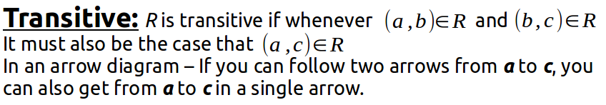
Properties of Relations
Without a diagram...
A = { 1, 2, 3, 4 },
R = { (1, 2), (1, 3), (1, 4), (2, 3), (2, 4), (3, 4) }
Is this transitive?

Slide 25
Properties of Relations
Without a diagram...
A = { 1, 2, 3, 4 },
R = { (1, 2), (1, 3), (1, 4), (2, 3), (2, 4), (3, 4) }
Is this transitive?
(1, 2) exists, (2, 3) exists, and (1, 3) exists.
(1, 2) exists, (2, 4) exists, and (1, 4) exists.
(1, 3) exists, (3, 4) exists, and (1, 4) exists.
… and so on …

Slide 26


Properties of Relations
Without a diagram...
A = { 1, 2, 3, 4 },
R = { (1, 2), (1, 3), (1, 4), (2, 3), (2, 4), (3, 4) }
Is it reflexive? Or irreflexive?

Slide 27
Properties of Relations
Without a diagram...
A = { 1, 2, 3, 4 },
R = { (1, 2), (1, 3), (1, 4), (2, 3), (2, 4), (3, 4) }
Is it reflexive? Or irreflexive?
None of these nodes point back to themselves, so it is irreflexive.

Slide 28
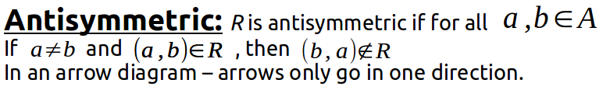
Properties of Relations
Without a diagram...
A = { 1, 2, 3, 4 },
R = { (1, 2), (1, 3), (1, 4), (2, 3), (2, 4), (3, 4) }
Is it antisymmetric?

Slide 29
Properties of Relations
Without a diagram...
A = { 1, 2, 3, 4 },
R = { (1, 2), (1, 3), (1, 4), (2, 3), (2, 4), (3, 4) }
Is it antisymmetric?
Each node only goes one way: (1, 2) but no (2, 1).
So it is antisymmetric.

Slide 30
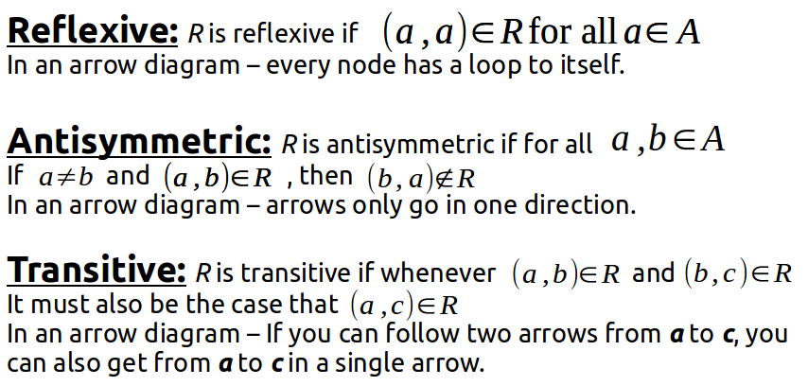
Properties of Relations
For the following relation on the set of integers:
Is this reflexive or irreflexive?

Slide 31
Properties of Relations
For the following relation on the set of integers:
Is this reflexive or irreflexive?
If we plug in a as (a, a)?
a + a = 2a, which is not odd. A node cannot loop back on itself, so it is irreflexive.

Slide 32
Properties of Relations
For the following relation on the set of integers:
Is this antisymmetric? Can we find some a, b and b, a that result in the same values?

Slide 33
Properties of Relations
For the following relation on the set of integers:
Is this antisymmetric? Can we find some a, b and b, a that result in the same values?
(2, 3) = 5, and (3, 2) = 5, so it is not antisymmetric.

Slide 34
Properties of Relations
For the following relation:
Is this reflexive?

Slide 35
Properties of Relations
For the following relation:
Is this reflexive?
No, you generally cannot get a flight from location “a” back to location “a” (at least not without another stop).

Slide 36
Properties of Relations
For the following relation:
Is this antisymmetric?

Slide 37
Properties of Relations
For the following relation:
Is this antisymmetric?
No, you can get a flight from “a” to “b” and from “b” to “a”.

Slide 38
Properties of Relations
For the following relation:
Is this transitive?
For this set, you can have a direct flight from “a” to “b”, and “b” to “c”, but not for “a” to “c”, as it is not defined in the set.

Slide 39
Properties of Relations
For the following relation:
Is this antisymmetric?

